Slide 1
Chapter-3
Improper Integrals
Gamma Function
and
Beta Function

Slide 2
3.1 Improper Integrals
An improper integral is an extended concept of a definite integral that has infinite limits on one or both ends of the interval and/or an integrand that becomes infinite at one or more points within the interval of integration .
Improper integral is called convergent if the limit of the integral exists with finite value and divergent if the limit of the integral does not exist or has infinite value.

Slide 3
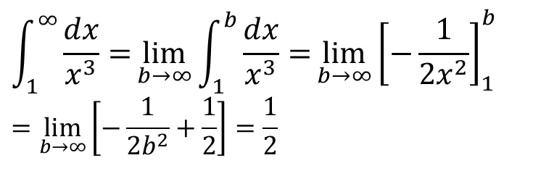
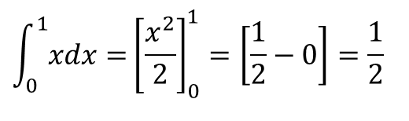
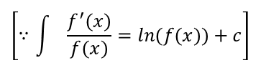
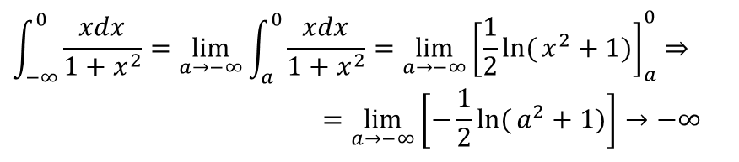
Example 3.1.1
$$\int_{0}^{1}{x​dx=}{\left[\frac{x^{2}}{2}\right]}_{0}^{1}=\left[\frac{1}{2}−0\right]=\frac{1}{2}$$
Definite Integral
Improper integral with infinite limit
$$\int_{1}^{∞}{\frac{dx}{x^{3}}=}\lim_{b→∞}{\int_{1}^{b}{\frac{dx}{x^{3}}=}}\lim_{b→∞}{{\left[−\frac{1}{2x^{2}}\right]}_{1}^{b}} \\ =\lim_{b→∞}\left[−\frac{1}{2b^{2}}+\frac{1}{2}\right]=\frac{1}{2}$$
Example 3.1.2
Convergent
Example 3.1.3
$$\int_{−∞}^{0}{\frac{xdx}{1+x^{2}}=\lim_{a→−∞}{\int_{a}^{0}{\frac{xdx}{1+x^{2}}={\lim_{a→−∞}\left[\frac{1}{2}\ln{(}x^{2}+1)\right]}_{a}^{0}}}}⇒ \\ =\lim_{a→−∞}\left[−\frac{1}{2}\ln{(}a^{2}+1)\right]→−∞$$
$$\left[∵\int{\frac{f^{′}(x)}{f(x)}=ln(f(x))+c}\right]$$
Divergent

Slide 4
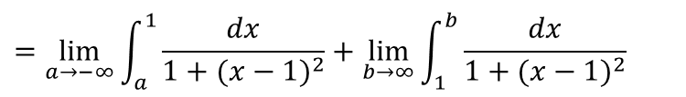
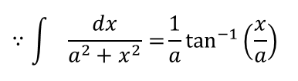
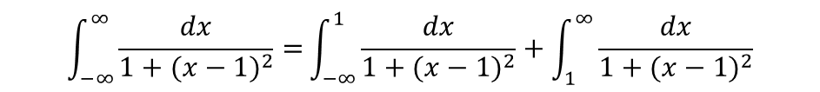
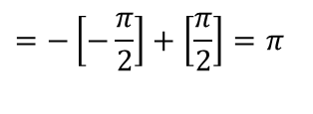
Example 3.1.4
$$\int_{−∞}^{∞}{\frac{dx}{1+(x−1)^{2}}=}\int_{−∞}^{1}{\frac{dx}{1+(x−1)^{2}}}+\int_{1}^{∞}{\frac{dx}{1+(x−1)^{2}}}$$
$$=\lim_{a→−∞}{\int_{a}^{1}{\frac{dx}{1+(x−1)^{2}}}}+\lim_{b→∞}{\int_{1}^{b}{\frac{dx}{1+(x−1)^{2}}}}$$
$$={\lim_{a→−∞}\left[\tan^{−1}{(}x−1)\right]}_{a}^{1}+{\lim_{b→∞}\left[\tan^{−1}{(}x−1)\right]}_{1}^{b}$$
$$∵\int{\frac{dx}{a^{2}+x^{2}}=}\frac{1}{a}\tan^{−1}\left(\frac{x}{a}\right)$$
$$=\lim_{a→−∞}\left[0−\tan^{−1}{(}a−1)\right]+\lim_{b→∞}\left[\tan^{−1}{(}b−1)−0\right]$$
$$=−\left[−\frac{π}{2}\right]+\left[\frac{π}{2}\right]=π$$

Slide 5
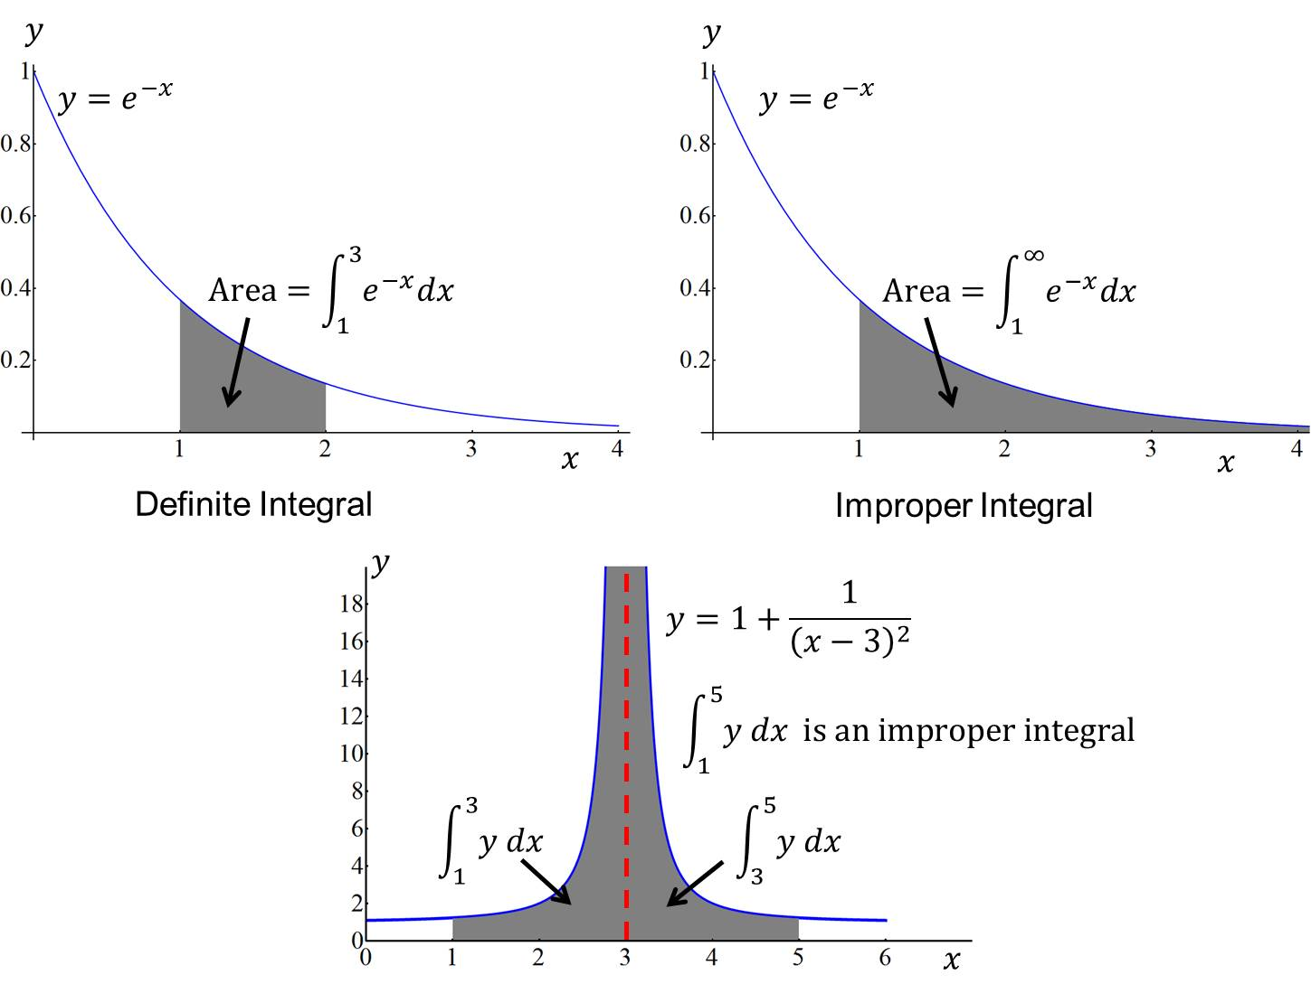
Geometrical concept of the definite integral and improper integral.

Slide 6

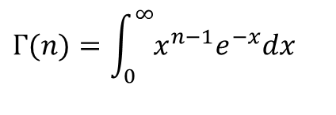
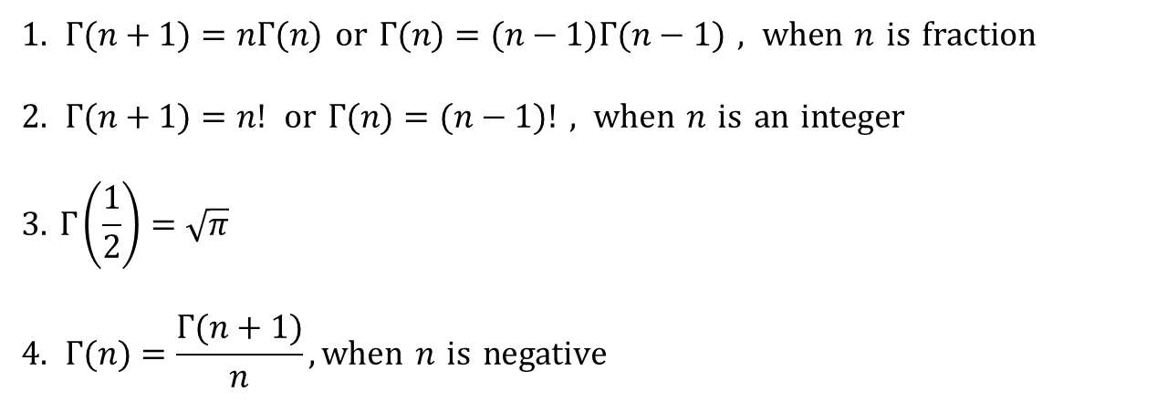
3.2 The Gamma function
The gamma function is denoted by is defined by
$$Γ(n)$$
$$Γ(n)=\int_{0}^{∞}{x^{n−1}e^{−x}dx}$$
where, for convergence of the integral, n> 0.
Some useful formula
$$1. Γ(n+1)=nΓ(n) \text{or} Γ(n)=(n−1)Γ(n−1) , \text{when} n \text{is} \text{fraction}$$
$$2. Γ(n+1)=n! \text{or} Γ(n)=(n−1)! , \text{when} n \text{is} \text{an} \text{integer}$$
$$\text{3.} Γ\left(\frac{1}{2}\right)=\sqrt{π}$$
$$4. Γ(n)=\frac{Γ(n+1)}{n},\text{when} n \text{is} \text{negative}$$

Slide 7
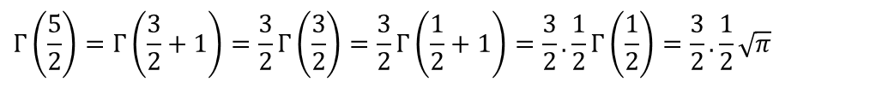
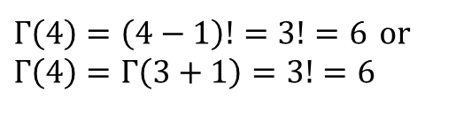
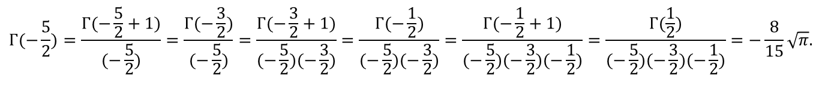
Example 3.2.1
$$Γ\left(\frac{5}{2}\right)=Γ\left(\frac{3}{2}+1\right)=\frac{3}{2}Γ\left(\frac{3}{2}\right)=\frac{3}{2}Γ\left(\frac{1}{2}+1\right)=\frac{3}{2}.\frac{1}{2}Γ\left(\frac{1}{2}\right)=\frac{3}{2}.\frac{1}{2}\sqrt{π}$$
OR
$$Γ\left(\frac{5}{2}\right)=\left(\frac{5}{2}−1\right)Γ\left(\frac{5}{2}−1\right)=\frac{3}{2}Γ\left(\frac{3}{2}\right)=\frac{3}{2}.\left(\frac{3}{2}−1\right)Γ\left(\frac{3}{2}−1\right)=\frac{3}{2}.\frac{1}{2}Γ\left(\frac{1}{2}\right)=\frac{3}{2}.\frac{1}{2}\sqrt{π}$$
Example 3.2.2
$$Γ(−\frac{5}{2})=\frac{Γ(−\frac{5}{2}+1)}{(−\frac{5}{2})}=\frac{Γ(−\frac{3}{2})}{(−\frac{5}{2})}=\frac{Γ(−\frac{3}{2}+1)}{(−\frac{5}{2})(−\frac{3}{2})}=\frac{Γ(−\frac{1}{2})}{(−\frac{5}{2})(−\frac{3}{2})}=\frac{Γ(−\frac{1}{2}+1)}{(−\frac{5}{2})(−\frac{3}{2})(−\frac{1}{2})}=\frac{Γ(\frac{1}{2})}{(−\frac{5}{2})(−\frac{3}{2})(−\frac{1}{2})}=−\frac{8}{15}\sqrt{π}.$$
Example 3.2.3
$$Γ\left(4\right)=\left(4−1\right)!=3!=6 \text{or} \\ Γ\left(4\right)=Γ\left(3+1\right)=3!=6$$

Slide 8
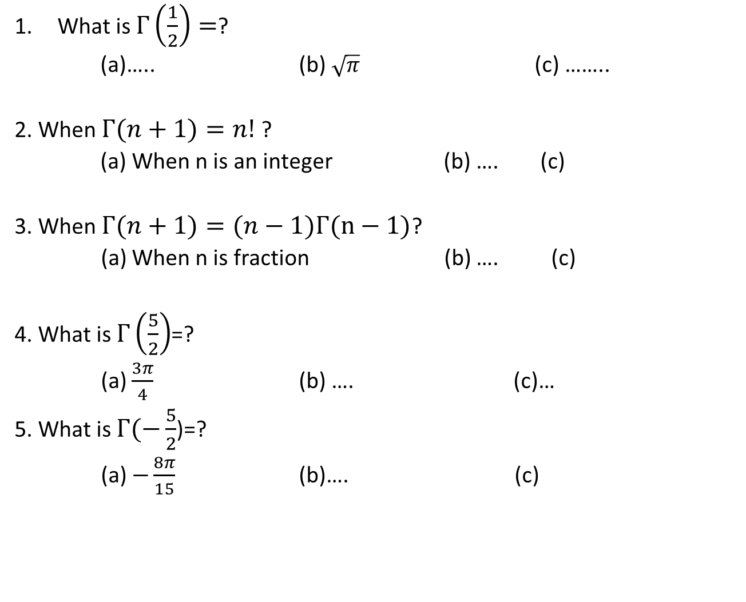
Sample MCQ
What is $Γ\left(\frac{1}{2}\right)=$?
(a)….. (b) $\sqrt{π}$ (c) ……..
2. When $Γ(n+1)=n!$?
(a) When n is an integer (b) …. (c)
3. When $Γ(n+1)=(n−1)Γ(n−1)$?
(a) When n is fraction (b) …. (c)
4. What is $Γ\left(\frac{5}{2}\right)$=?
(a) $\frac{3π}{4}$ (b) …. (c)…
5. What is $Γ(−\frac{5}{2}$)=?
(a) $−\frac{8π}{15}$ (b)…. (c)

Slide 9
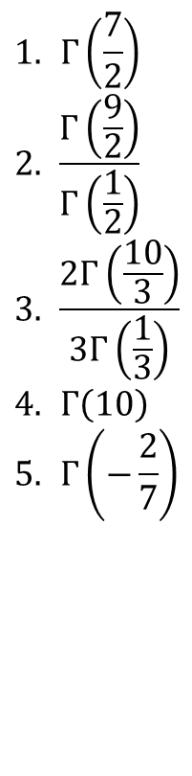
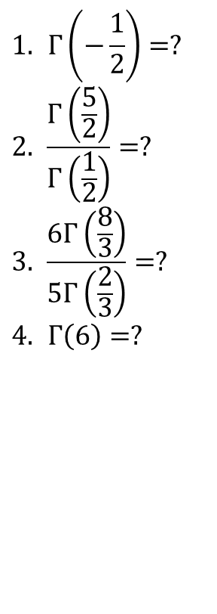
Class practice
Home work
3.2.1
$$1. Γ\left(−\frac{1}{2}\right)=? \\ 2. \frac{Γ\left(\frac{5}{2}\right)}{Γ\left(\frac{1}{2}\right)}=? \\ 3. \frac{6Γ\left(\frac{8}{3}\right)}{5Γ\left(\frac{2}{3}\right)}=? \\ 4. Γ\left(6\right)=?$$
$$1. Γ\left(\frac{7}{2}\right) \\ 2. \frac{Γ\left(\frac{9}{2}\right)}{Γ\left(\frac{1}{2}\right)} \\ 3. \frac{2Γ\left(\frac{10}{3}\right)}{3Γ\left(\frac{1}{3}\right)} \\ 4. Γ\left(10\right) \\ 5.​ Γ\left(−\frac{2}{7}\right)$$

Slide 10
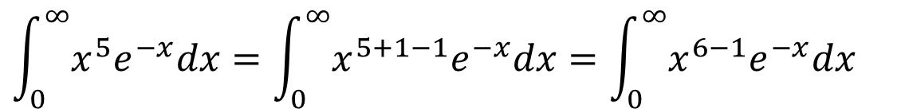
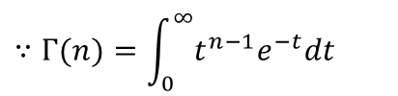
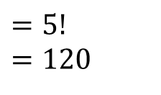

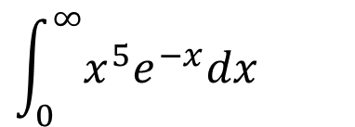
$$\int_{0}^{∞}{x^{5}e^{−x}dx}$$
Example 3.2.4: Solve the integral
Solution:
$$\int_{0}^{∞}{x^{5}e^{−x}dx}=\int_{0}^{∞}{x^{5+1−1}e^{−x}dx}=\int_{0}^{∞}{x^{6−1}e^{−x}dx}$$
$$=Γ(6)$$
$$∵Γ(n)=\int_{0}^{∞}{t^{n−1}e^{−t}dt}$$
$$=5!=120$$

Slide 11
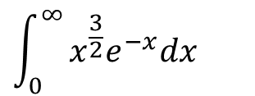
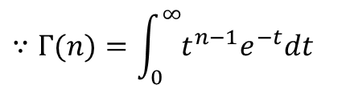
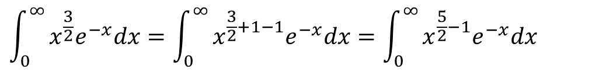
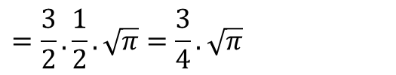
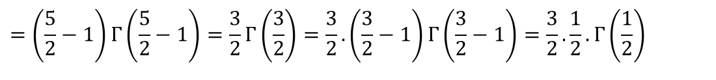
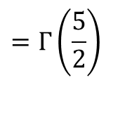
$$\int_{0}^{∞}{x^{\frac{3}{2}}e^{−x}dx}$$
Example 3.2.5: Solve the integral
Solution:
$$\int_{0}^{∞}{x^{\frac{3}{2}}e^{−x}dx}=\int_{0}^{∞}{x^{\frac{3}{2}+1−1}e^{−x}dx}=\int_{0}^{∞}{x^{\frac{5}{2}−1}e^{−x}dx}$$
$$=Γ\left(\frac{5}{2}\right)$$
$$∵Γ(n)=\int_{0}^{∞}{t^{n−1}e^{−t}dt}$$
$$=\left(\frac{5}{2}−1\right)Γ\left(\frac{5}{2}−1\right)=\frac{3}{2}Γ\left(\frac{3}{2}\right)=\frac{3}{2}.\left(\frac{3}{2}−1\right)Γ\left(\frac{3}{2}−1\right)=\frac{3}{2}.\frac{1}{2}.Γ\left(\frac{1}{2}\right)$$
$$=\frac{3}{2}.\frac{1}{2}.\sqrt{π}=\frac{3}{4}.\sqrt{π}$$

Slide 12
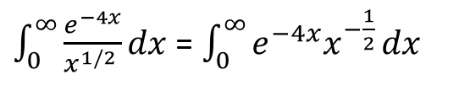

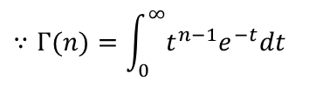
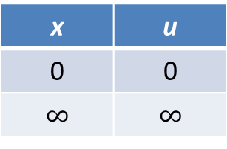

Example 3.2.6: Consider the integral$\int_{0}^{∞}{\frac{e^{−4x}}{x^{1/2 }}}dx$ .
Solution:
$\int_{0}^{∞}{\frac{e^{−4x}}{x^{1/2 }}}dx$ = $\int_{0}^{∞}{e^{−4x}x^{−\frac{1}{2}}}dx$
Changing Limit
Let, $u=4x i.e. x=u/4$ $∴dx=\frac{du}{4}$
The integral becomes
$\int_{0}^{∞}{e^{−u}{\left(\frac{u}{4}\right)}^{−\frac{1}{2}}.\frac{du}{4}}$
$$=\frac{1}{2}\int_{0}^{∞}{u^{−1/2}e^{−u} du}$$
$=\frac{1}{2}Γ\left(\frac{1}{2}\right)$
$=\frac{1}{2}\sqrt{π}$ .
x | u
0 | 0
$$∞$$ | $$∞$$
$$∵Γ(n)=\int_{0}^{∞}{t^{n−1}e^{−t}dt}$$

Slide 13
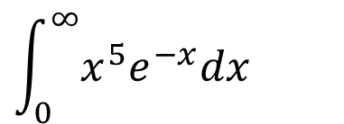

Sample MCQ
1. Evaluate
(a)…. (b) $Γ(6)$ (c) ……..
2. Evaluate $\int_{0}^{∞}{x^{\frac{3}{2}}e^{−x}dx}$
(a) $Γ\left(\frac{5}{2}\right)$ (b) …. (c)
$$\int_{0}^{∞}{x^{5}e^{−x}dx}$$

Slide 14
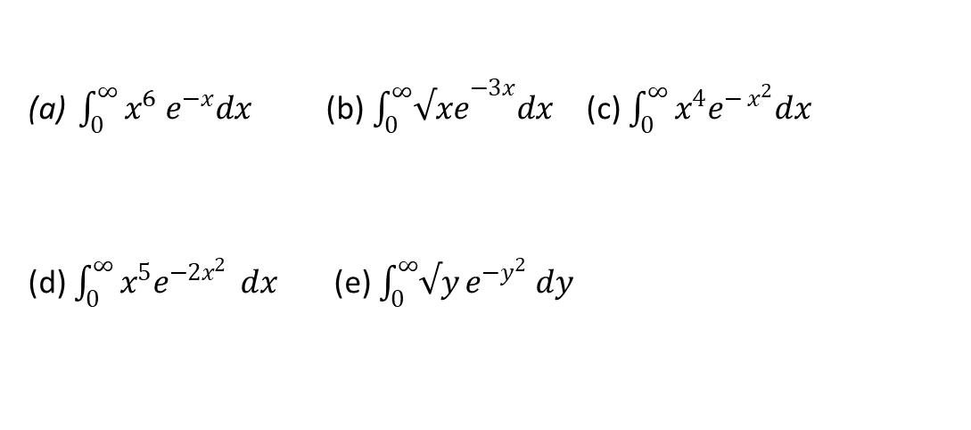
Home work
3.2.2
$\int_{0}^{∞}{x^{6}{ e}^{−x}dx}$ (b)$\int_{0}^{∞}{{√xe}^{−3x}dx}$ (c) $\int_{0}^{∞}{x^{4}e^{{− x}^{2}}dx}$
(d) $\int_{0}^{∞}{x^{5}e^{−2x^{2}}} dx$ (e) $\int_{0}^{∞}{√y}e^{−y^{2}} dy$

Slide 15
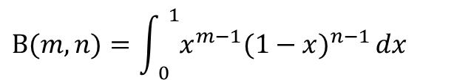

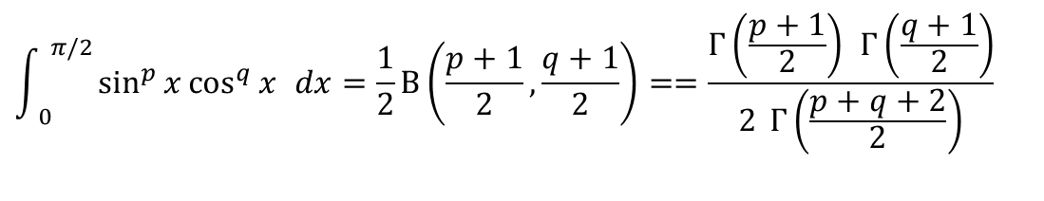
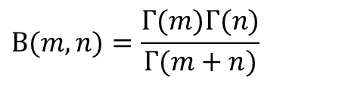
3.3 The Beta function
The beta function is denoted by is defined by
$Β(m,n)$
$$Β(m,n)=\int_{ 0}^{ 1}{x^{m−1}(1−x)^{n−1}}dx$$
where, for convergence of the integral, m> 0, n> 0.
Relation between the Gamma- and Beta Functions
$$Β(m,n)=\frac{Γ(m)Γ(n)}{Γ(m+n)}$$
Gamma- and Beta Functions could be used to solve the following particular integral
$$\int_{ 0}^{ π/2}{\sin^{p}{x}\cos^{q}{x} dx=\frac{1}{2}Β\left(\frac{p+1}{2},\frac{q+1}{2}\right)}==\frac{Γ\left(\frac{p+1}{2}\right) Γ\left(\frac{q+1}{2}\right)}{2 Γ\left(\frac{p+q+2}{2}\right)}$$

Slide 16
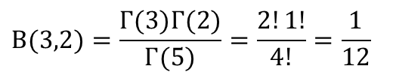

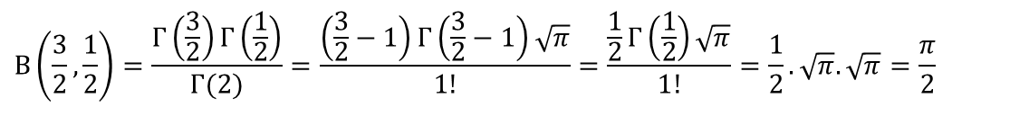
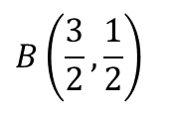
Example 3.3.1: Evaluate
$$B(3,2)$$
Solution:
$$Β(3,2)=\frac{Γ(3)Γ(2)}{Γ(5)}=\frac{2!1!}{4!}=\frac{1}{12}$$
$$B\left(\frac{3}{2},\frac{1}{2}\right)$$
Example 3.3.2: Evaluate
Solution:
$$Β\left(\frac{3}{2},\frac{1}{2}\right)=\frac{Γ\left(\frac{3}{2}\right)Γ\left(\frac{1}{2}\right)}{Γ(2)}=\frac{\left(\frac{3}{2}−1\right)Γ\left(\frac{3}{2}−1\right)\sqrt{π}}{1!}=\frac{\frac{1}{2}Γ\left(\frac{1}{2}\right)\sqrt{π}}{1!}=\frac{1}{2}.\sqrt{π}.\sqrt{π}=\frac{π}{2}$$

Slide 17
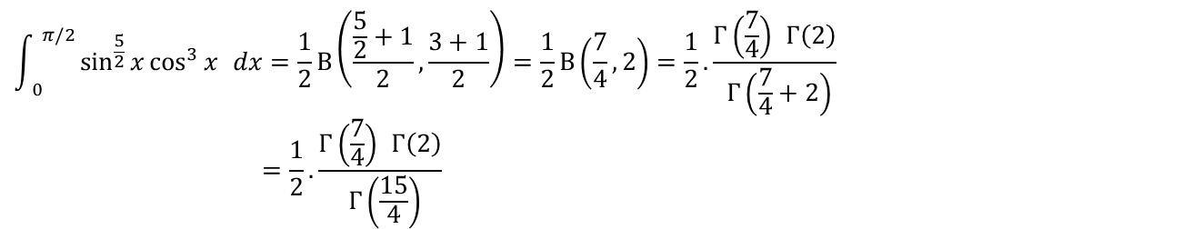
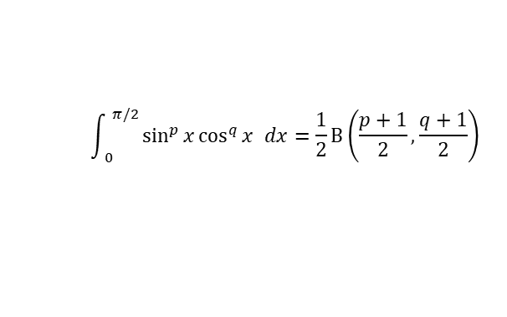
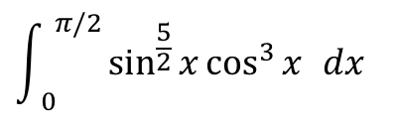

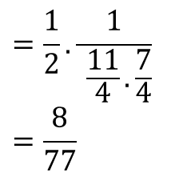
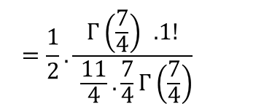
$$\int_{ 0}^{ π/2}{\sin^{p}{x}\cos^{q}{x} dx=\frac{1}{2}Β\left(\frac{p+1}{2},\frac{q+1}{2}\right)}$$
$$Β(m,n)=\frac{Γ(m)Γ(n)}{Γ(m+n)}$$
$$\int_{ 0}^{ π/2}{\sin^{\frac{5}{2}}{x}\cos^{3}{x} dx}$$
Example 3.3.3: Evaluate
Solution:
$$\int_{ 0}^{ π/2}{\sin^{\frac{5}{2}}{x}\cos^{3}{x} dx=\frac{1}{2}Β\left(\frac{\frac{5}{2}+1}{2},\frac{3+1}{2}\right)}=\frac{1}{2}Β\left(\frac{7}{4},2\right)=\frac{1}{2}.\frac{Γ\left(\frac{7}{4}\right) Γ\left(2\right)}{ Γ\left(\frac{7}{4}+2\right)}$$
$$=\frac{1}{2}.\frac{Γ\left(\frac{7}{4}\right) Γ\left(2\right)}{ Γ\left(\frac{15}{4}\right)}$$
$$=\frac{1}{2}.\frac{Γ\left(\frac{7}{4}\right) .1!}{ \frac{11}{4}.\frac{7}{4}Γ\left(\frac{7}{4}\right)}$$
$$=\frac{1}{2}.\frac{1}{ \frac{11}{4}.\frac{7}{4}} =\frac{8}{77}$$

Slide 18
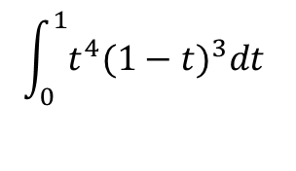

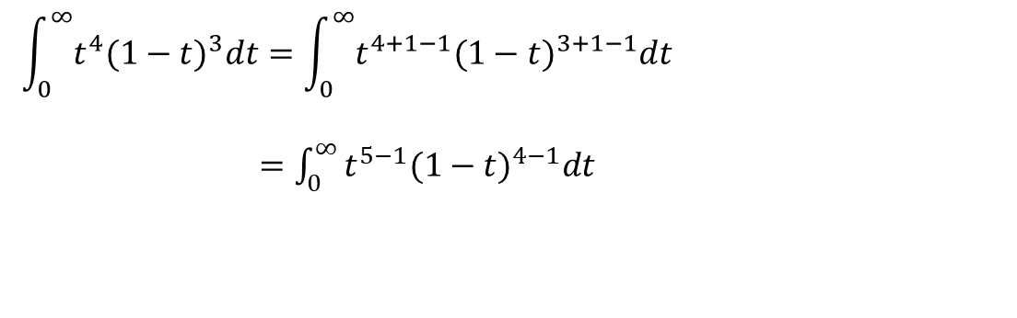

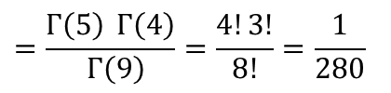

$$\int_{0}^{1}{t^{4}(1−t)^{3}dt}$$
Example 3.3.4: Solve the integral
Solution:
$$\int_{0}^{∞}{t^{4}(1−t)^{3}dt}=\int_{0}^{∞}{t^{4+1−1}(1−t)^{3+1−1}dt}$$
$=\int_{0}^{∞}{t^{5−1}(1−t)^{4−1}dt}$
$$=B(5,4)$$
$$Β(m,n)=\int_{ 0}^{ 1}{x^{m−1}(1−x)^{n−1}}dx$$
$$=\frac{Γ\left(5\right) Γ\left(4\right)}{ Γ\left(9\right)}=\frac{4!3!}{8!}=\frac{1}{280}$$
$$Β(m,n)=\frac{Γ(m)Γ(n)}{Γ(m+n)}$$

Slide 19
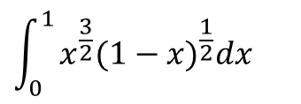
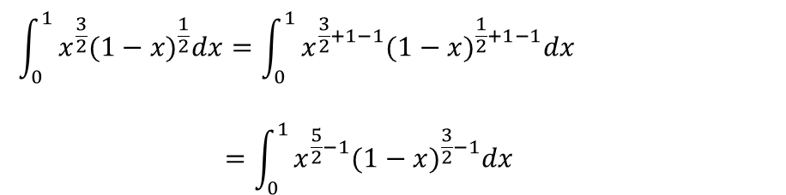


$$\int_{0}^{1}{x^{\frac{3}{2}}(1−x)^{\frac{1}{2}}dx}$$
Example 3.3.5: Solve the integral
Solution:
$$\int_{0}^{1}{x^{\frac{3}{2}}(1−x)^{\frac{1}{2}}dx}=\int_{0}^{1}{x^{\frac{3}{2}+1−1}(1−x)^{\frac{1}{2}+1−1}dx}$$
$$=\int_{0}^{1}{x^{\frac{5}{2}−1}(1−x)^{\frac{3}{2}−1}dx}$$
$$=B\left(\frac{5}{2},\frac{3}{2}\right)$$
$$=\frac{Γ\left(\frac{5}{2}\right) Γ\left(\frac{3}{2}\right)}{ Γ\left(\frac{5}{2}+\frac{3}{2}\right)}=\frac{Γ\left(\frac{5}{2}\right) Γ\left(\frac{3}{2}\right)}{ Γ\left(4\right)}=\frac{\frac{3}{2}.\frac{1}{2}.\sqrt{π}.\frac{1}{2}.\sqrt{π}}{3!}=\frac{π}{16}$$

Slide 20





$$\int_{0}^{2}{\frac{x^{2}}{\sqrt{2x−x^{2}}}dx}$$
Example 3.3.6 Solve the integral
Solution:
$$I=\int_{0}^{2}{\frac{x^{2}}{\sqrt{2x−x^{2}}}dx}$$
$$=\int_{0}^{2}{\frac{x^{2}}{\sqrt{2x\left(1−\frac{x}{2}\right)}}dx}$$
$$=\frac{1}{\sqrt{2}}\int_{0}^{2}{x^{2}.x^{−\frac{1}{2}}{\left(1−\frac{x}{2}\right)}^{−\frac{1}{2}}dx}$$
$$=\frac{1}{\sqrt{2}}\int_{0}^{2}{x^{\frac{3}{2}}{\left(1−\frac{x}{2}\right)}^{−\frac{1}{2}}dx}$$

Slide 21





$$\text{Let}, u=\frac{x}{2} i.e. x=2u ∴dx=2du$$
Changing Limit
$$I=\frac{1}{\sqrt{2}}\int_{0}^{1}{(2u)^{\frac{3}{2}}{\left(1−u\right)}^{−\frac{1}{2}}2du}$$
$$=2.2^{−\frac{1}{2}}.2^{\frac{3}{2}}\int_{0}^{1}{u^{\frac{3}{2}+1−1}{\left(1−u\right)}^{−\frac{1}{2}+1−1}du}$$
$=4\int_{0}^{1}{u^{\frac{5}{2}−1}{\left(1−u\right)}^{\frac{1}{2}−1}du}$
x | u
0 | 0
$$2$$ | $$1$$
$$=4B\left(\frac{5}{2},\frac{1}{2}\right)$$
$$=4.\frac{Γ\left(\frac{5}{2}\right) Γ\left(\frac{1}{2}\right)}{ Γ\left(\frac{5}{2}+\frac{1}{2}\right)}=4.\frac{Γ\left(\frac{5}{2}\right) Γ\left(\frac{1}{2}\right)}{ Γ\left(3\right)}=4.\frac{\frac{3}{2}.\frac{1}{2}.\sqrt{π}.\sqrt{π}}{2!}=4.\frac{3π}{8}=\frac{3π}{2}$$

Slide 22

Sample MCQ
1. What is the Relation between the Gamma- and Beta Functions?
(a)…. (b) $Β(m,n)=\frac{Γ(m)Γ(n)}{Γ(m+n)}$ (c) ……..
2. Evaluate$B(3,2)$
(a) $\frac{1}{2}$ (b) …. (c)
3. Evaluate$B\left(\frac{3}{2},\frac{1}{2}\right)$
(a) $\frac{π}{2}$ (b) …. (c)
3. Evaluate$\int_{0}^{1}{t^{4}(1−t)^{3}dt}$
(a) $B(5,4)$ (b) …. (c)

Slide 23

Home work
3.3
(a) $\int_{0}^{1}{x^{4}{\left(1−x\right)}^{3} dx }$(b)$\int_{0}^{4}{\frac{x^{2}}{\sqrt{4−x}}} d$ (c) $\int_{0}^{1}{y^{4}\sqrt{1−y^{2} }dy}$
(d)$\int_{0}^{π/2}{\sin^{6}{θ dθ}}$ (e) $\int_{− π/2}^{π/2}{\cos^{3}{θ dθ}}$ (f) $\int_{0}^{π/2}{\sin^{4}θ{\cos^{5}θ{dθ}}}$
(g) $B\left(\frac{7}{2},1\right) (h)$ $B\left(10,11\right)$

